Slide 1
REASONS WHY ORGANIZATIONAL STRUCTURES DIFFER
By: (Insert your Name here)

Slide 2
Definition of Organizational Structures
Organizational structure is simply how varies activities are directed and done within an organization to achieve the organizational goals.
It is a system of how things are done within and organization.
Organizational structure defines how all activities within an organizations are coordinated and synchronized for achievement of set goals and objectives.
The activities that define an organization structure include things such as roles, responsibilities, supervision, coordination of employees, allocating tasks, recruitment and placement of new employees among other activities.
Notes:
Organizational structure is the framework that guideless the activities of an organization. It therefore defines how various activities are performed to realize the goals and objectives set by the organization and by various departments within the organizations. Organizational structure, therefore, is simply how an organization operates and how various activities are done ranging from supervision and assigning job tasks to complex managerial decision making for achievement of organizational goals.

Slide 3
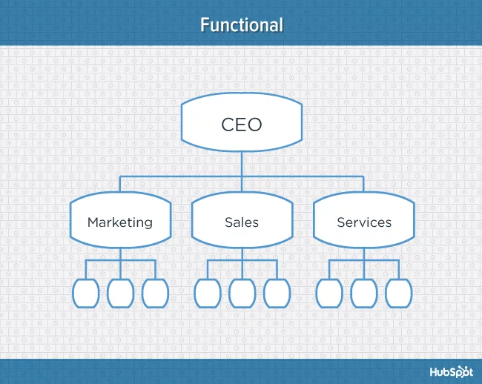
Diagrammatical presentation of Organizational Structure
Devany (2018) defines organizational structure as a visual diagram of a company that describes what employees do, whom they report to, and how decisions are made across the business. Organizational structures can use functions, markets, products, geographies, or processes as their guide, and cater to businesses of specific sizes and industries.
The image on the right is an example of a functional organizational structure.

Slide 4
4 Reasons why Organizational Structures Differ
Organizational structures differ because of various reasons.
However, the for major reasons as to why organizational structures differ are:
Differences in organizational strategies
Differences in Organizational sizes
Differences in technology used in organizations
Differences in Environmental Conditions.
Notes:
Varying organizational structures are brought about by variations in sizes of organizations, variations in use of technology and strategies.
The fact that organizations operate in different environments also necessitate different organizational structures. This is because the goals and objectives of organizations are different in different regions.

Slide 5
1. Strategy
Definition:
Organization strategy is defined as the direction and scope of an organization over the long term. It ideally matches its resources to its changing environment, and in particular its markets, customers or clients so as to meet stakeholder expectations (Feurer & Chaharbaghi, 1995).
Strategy is the primary means of reaching the focal objective. The focal objective is whatever objective is in mind of organizational managers and stakeholders at the moment
Notes:
From Feurer & Chaharbaghi definition of strategy, it is clear that strategy of an organization is the focus which directs the activities and operations of the organization by matching the organizational resources to the expectations of the various stakeholders of the organization and in view of the organizational goals.
Strictly speaking, it is literally meaningless to talk about strategy without having an objective in mind. Viewed in this context strategy becomes an integral part of the ends-means hierarchy (Feurer, R., & Chaharbaghi, 1995).

Slide 6
Strategy and Organizational Structures
A business strategy defines the direction of the organization.
Every organization employees a different strategy to achieve organizational goals.
Therefore, two organizations that employee different strategies cannot have the same organizational structures.
For example, an organization whose strategy is directed towards increasing sales in the global market is different from the strategy of an organization whose direction is to take control of the local market.
Thus, different organizations means different organizational strategies and this consequently means difference in organizational structures between the organizations.

Slide 7
2. Differences in Organizational Sizes
Bigger organizations have hierarchical organizational structures that show a chain of command to ensure that each group of employees have somewhere to report to.
Smaller organizations might only need close coordination of the employees without necessarily creating hierarchical chains of command.
Therefore, the size of the organization determines which organization structure fits and this creates a variation in structures of big organizations and those of smaller organizations.

Slide 8
3. Differences in Technology Use
Organizational structures differ from one organization to another because of the differences in the use of technology among those organizations.
Organizations that have fully incorporated use of technology in there operations for example automation of manufacturing, eliminate the need for extra managerial departments in the organization and replace them with technical departments.
Such organizations communicate easily through gadgets such computers and scroll boards.
There operations are different from those that partially use modern technology.
This creates a difference in the manner in which activities in these organizations are performed and thus, a difference in organizational structures.

Slide 9
4. Differences in Environments
Organizational structures differ in different regions and cultures.
For example, structures of organizations operating within Islamic cultures will greatly differ from the structures of those organizations operating from Christianity cultures.
In such situations, there is a difference in values and practices.
There might also be a difference in political as well as economic stability ion regions where two or more organizations are operating and this creates a difference in their strategies of achieving stakeholder expectations and organizational goals.

Slide 10
Conclusion
In conclusion, Organizations apply different approaches depending on their sizes and this explains the difference that exists in organizational structures among organizations.
Environmental differences is also very crucial in creating the existing difference in organizational structures.
Therefore, it is very difficult for a small organization to emulate the structure of a bigger organization because of the financial constrains and the differences in strategic directions between the two organizations.
Notes:
Only those organization operating within the same environment and having the same capacity in terms of workers and technology use can try o emulate the organizational structures of each other.

Slide 11
References
Feurer, R., & Chaharbaghi, K. (1995). Strategy development: Past, present and future. Management Decision, 33(6), 11. Retrieved from https://search-proquest-com.libraryresources.columbiasouthern.edu/docview/212111783?accountid=33337
Devaney, E. (2018). 7 Types of Organizational Structure & Whom They're Suited For [Diagrams]. Accessed on 9th April 2019 from https://blog.hubspot.com/marketing/team-structure-diagrams

